Slide 1

Intake Work Session Openloop | Medplum
2025.11.19

Slide 2

Agenda
FHIR Basics
Clinical Context
Questionnaires and Patient Intake

Slide 3
FHIR Basics
Notes:
[Title slide]
Good morning, and Welcome to PlumCon!
Thank you all so much for being here. This is our first annual conference, and I’m incredibly excited to be with you all today.

Slide 4
Why FHIR?
Interoperability: Increasingly, healthcare partners are exposing their data via FHIR APIs. Storing your data according to FHIR spec smooths the path to interoperating with multiple partners
Future Proof: The FHIR spec anticipates many of the complexities that arise in the healthcare domain, helping teams avoid these backend rewrites.
Data Hygiene: FHIR has a steep learning curve up front, but enforcing good data hygiene up front makes compliance, reporting, and billing much easier down the line.

Slide 5
Resources
{
"resourceType": "Patient",
// Unique id for this resource
"id": "j_chalmers",
// Patient Name (could have multiple)
"name": [
{
"use": "official",
"family": "Chalmers",
"given": ["Peter", "James"]
}
],
// Phone + email info
"telecom": [
{
"system": "phone",
"value": "(03) 3410 5613",
"use": "mobile"
}
],
//…
}
Object Store: FHIR data is stored as JSON objects known as “resources”
Resource Types: 150+ Resource Types represent a broad range of healthcare concepts:
Concrete entities ( Patient, Medication, Device)
Abstract concepts ( Procedure, Care Plan, Encounter)
Id: All resources have an “id” field which serves as their unique identifier.
Medplum Resource Types: Medplum extends the FHIR spec with its own resources types, primarily related to Auth and User administration
https://www.medplum.com/docs/fhir-basics#storing-data-resources

Slide 6
FHIR Search: Retrieving sets of resources from the server
FHIR Search: FHIR defines a rich set of query parameters to retrieve sets of resources that fulfill certain criteria
REST vs. GraphQL: FHIR provides both a REST and GraphQL API for searching resources. However, the GraphQL specification only contains a subset of functionality of the REST API (see GraphQL vs REST APIs in Medplum)

Slide 7
Basic Search Concepts
Search Parameters: Resource elements that are allowed to be searched / sorted.
Search Parameter Modifiers: Change the behavior of search parameters.
Including Linked Resources: Retrieve multiple resources, of different types, that reference an “anchor” resource.
Chained Search: Filter “anchor” resources based on referenced/referencing resources.

Slide 8
Identifiers
Identifiers: The same resource can have many different unique identifiers, depending on the context.
FHIR allows resources to be annotated with multiple identifiers simultaneously
Especially useful when syncing data from external systems
{
// Resource Type (i.e. "class name")
"resourceType": "Patient",
// Unique id for this resource
"id": "j_chalmers",
// Patient Name (could have multiple)
"name": [
{
"use": "official",
"family": "Chalmers",
"given": ["Peter", "James"]
}
],
"identifier": [
// Social Security Number ID (US-SSN)
{
"system": "http://hl7.org/fhir/sid/us-ssn",
"value": "011-11-1234"
},
// MRN - Hospital 1
{
"system": "http://hospital-1.org",
"value": "MRN-12345678"
},
// MRN - Hospital 2
{
"system": "http://hospital-2.org",
"value": "0987AZ6"
}
]
}
{
"system": ":systemUrl",
“value”: “:identifier”
}
https://www.medplum.com/docs/fhir-basics#naming-data-identifiers

Slide 9
Codeable Concepts: Standardizing Data
{
text: 'Tylenol 325 MG Oral Tablet'
coding: [
{
system: 'http://hl7.org/fhir/sid/ndc',
code: '50580045850'
}
{
system: 'http://www.nlm.nih.gov/research/umls/rxnorm',
code: '209387'
}
]
Code Systems: Healthcare operations depend codes to provide common names for concepts: procedures, diagnoses, and clinical results
LOINC, SNOMED, CPT, ICD, HCPCS
CodeableConcept: FHIR data type to annotate a given healthcare concept with (multiple) codes
{
"text":"description-of-concept",
"coding": [
{
"system": ":systemUrl",
“code”: “:code”
}
]
}
https://www.medplum.com/docs/fhir-basics#standardizing-data-codeable-concepts

Slide 10
Code Systems
Well Defined Service Menu: Beginning with a well-defined set of codes will streamline your build and simplify billing and reporting
CPT: What was done
ICD-10: Why it was done
LOINC: Measurable results
SNOMED: Provider Roles / additional concepts

Slide 11
ValueSets
ValueSets: Subsets of codes selected for a specific semantic purpose.
ValueSets can be bound to certain FHIR elements to define the set of possible values
ValueSetAutocomplete: React component that can be bound to a ValueSet and used as input for ValueSet bound fields
Pregnancy Status (LOINC 82810-3)
Possible pregnancy (situation) | 146799005 (SNOMED)
Not pregnant (finding) | 60001007 (SNOMED)
Pregnancy (finding) | 77386006 (SNOMED)
Unknown | UNK (HL7 Null)

Slide 12
Logical References
Most clinical workflows are comprised of multiple FHIR resources; captures the complexity of healthcare workflows.
References link related resources together, similar to foreign keys in traditional databases
Syntax:
{
"resourceType": "Task",
"id": "medrx002",
// Reference to the patient for whom medication is being ordered
"for": {
"type": "Patient",
"identifier": {
system: "http://example.com/",
value: “12321321”
}
}
}
{
"reference":":resourceType/:id",
"display": ":display string"
"type": ":resourceType"
"identifier": ":identifier"
}

Slide 13
Data Modeling Process
Data modeling consists of multiple layers
Structure: Which FHIR resources map to the data elements you are storing?
Terminology: Which codes and code systems represent the specific concepts you are representing.
Lifecycle: How to model different resource fields as they move through your workflow
Different communities publish implementation guides - guidance on how to use the FHIR spec within a specific context
US Core - Guidance from ONC on how to represent USCDI Data Elements within FHIR.
Lifecycle
Terminology
Structure

Slide 14
Medplum FHIR Basics
Lifecycle
Terminology
Structure

Slide 15
Clinical Context
Notes:
[Title slide]
Good morning, and Welcome to PlumCon!
Thank you all so much for being here. This is our first annual conference, and I’m incredibly excited to be with you all today.

Slide 16
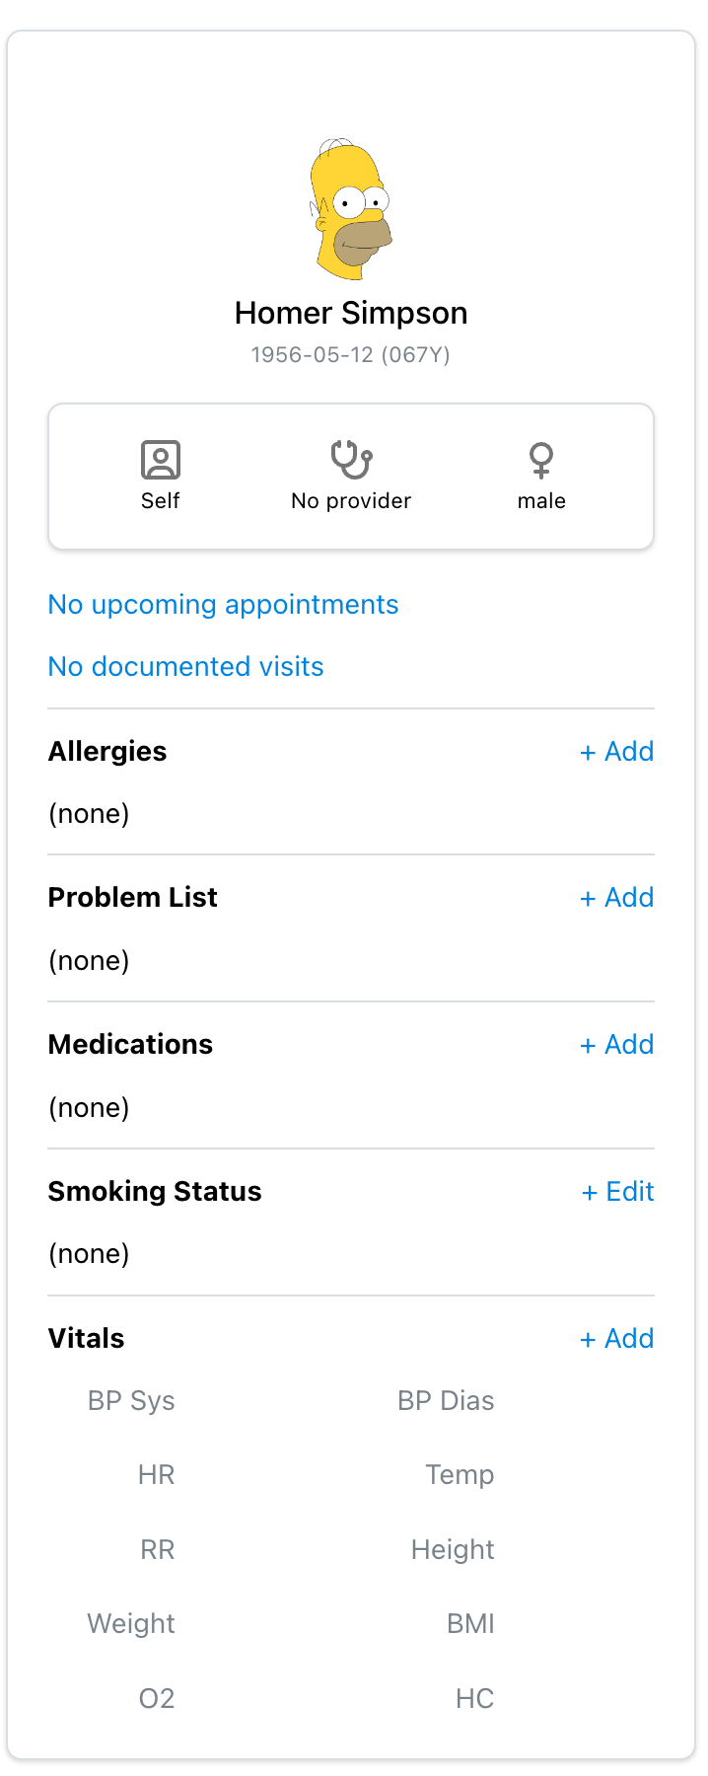
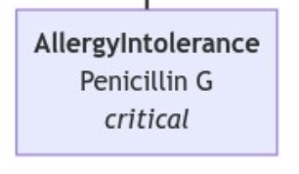
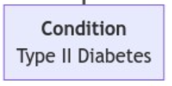
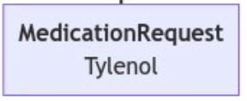
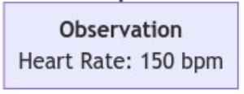
Clinical Context Model

Slide 17
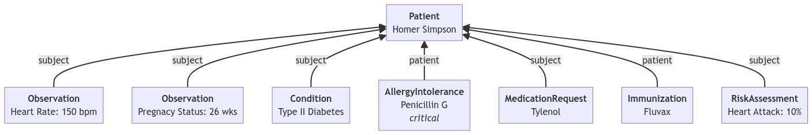
Clinical Context Model

Slide 18
Observation
Observation: Structured representations of point-in-time clinical measurement.
Can be quantitative (e.g. heart rate) or qualitative (e.g. eye color).
Records
Type
Value
Interpretation
Reference range (with ObservationDefinition)
Use LOINC codes for compliance, billing, and reporting.
Reference
Capturing Vital Signs
Reference Ranges
LOINC Codes
FHIR Workflow Patterns
Applications
Vital Signs
Diagnostic Lab Results
Physical Patient Measurements
Smoking Status

Slide 19
Risk Assessment
RiskAssessment: Specialized form of Observation used to model propensity for an adverse outcome.
Can record quantitative risk (e.g. 90%) as well as qualitative risk (e.g. “Very High”).
Use LOINC codes for compliance, billing, and reporting.
Applications
Clinical Prognosis
Infection Risk
Risk due to lifestyle factors

Slide 20
Condition
Condition: Records a long-term diagnosis for a patient.
Corresponds to EHR “problems list.”
Records
Type
Onset / Resolution
Severity / Progression
Verification Status
Use ICD-10 codes for interoperability and billing.
Reference
Insurance Eligibility Check
Particle Health Integration
Applications
SDOH
Chronic conditions
Substance Use / Abuse
Mental / Cognitive Impairment
Physical Disability / Impairment

Slide 21
Allergy Intolerance
AllergyIntolerance: Used for a specific type of risk: adverse reaction to drug or substance.
Records
Type
Confirmation status
Manifestation
US Core recommends a combination of RXNORM (drug) and SNOMED (substance) codes
Applications
Drug allergies
Food allergies

Slide 22
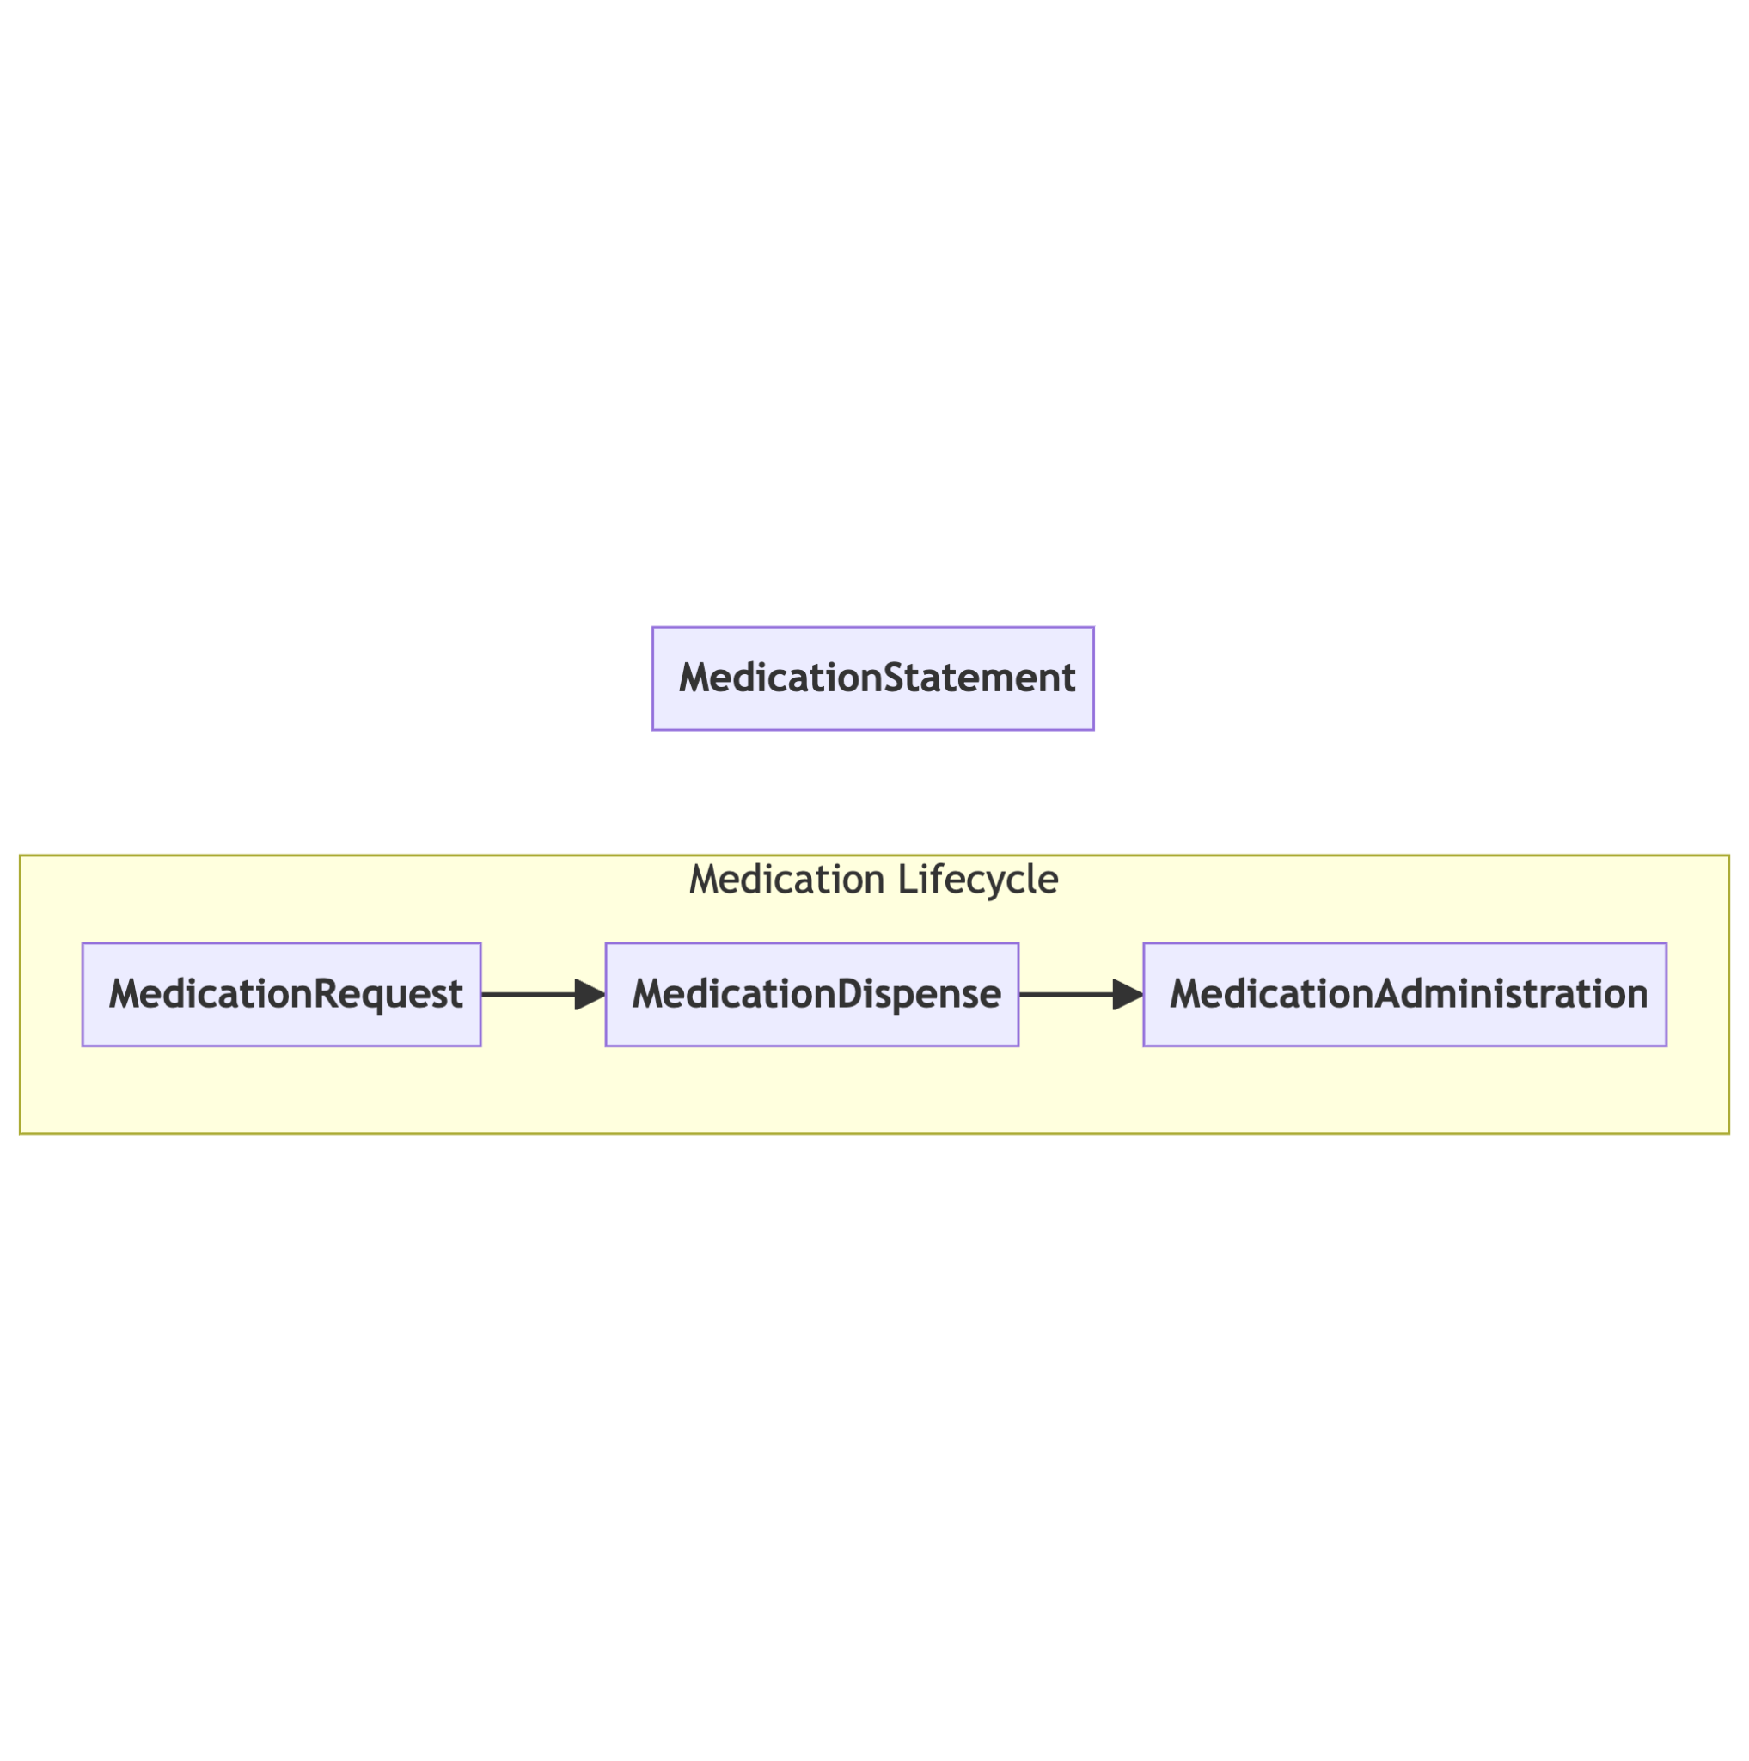
Medication
FHIR has multiple resources related to the medication lifecycle
MedicationRequest - order/prescription
MedicationDispense - drug supplied to patient
MedicationAdministration - patient ingests drug
MedicationStatement - provides a summary statement of drug
US Core recommends MedicationRequest to track patient’s medication list
Drug code (RXNorm)
date/time
Supporting reason / diagnosis
Dosage

Slide 23
Intake and Assessments
Notes:
[Title slide]
Good morning, and Welcome to PlumCon!
Thank you all so much for being here. This is our first annual conference, and I’m incredibly excited to be with you all today.

Slide 24
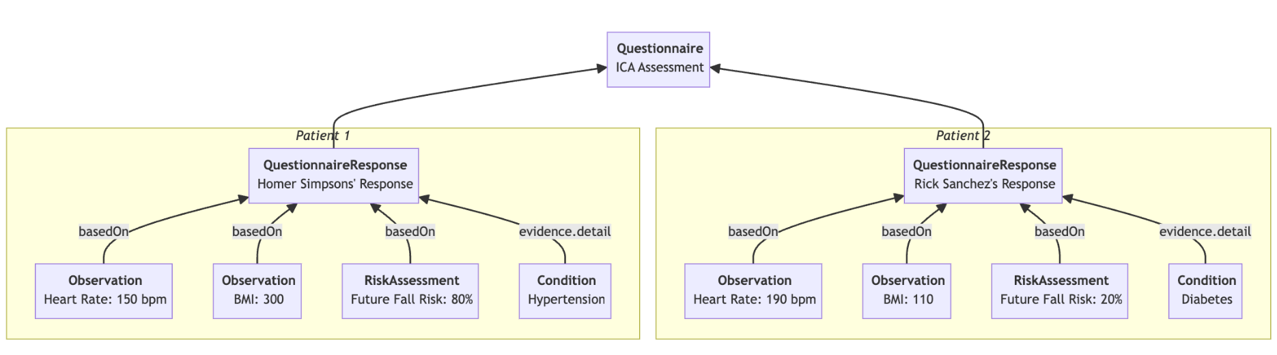
Assessments

Slide 25
Assessments
Questionnaire: Definition of questions/answers. 1 per form.
Prefer standard assessments where available
Tag each question / answer with appropriate LOINC codes for reporting.
LOINC has predefined standard assessments
NLM form builder can generate standardized assessments in FHIR format
QuestionnaireResponse: Patient’s responses to each question. 1 per patient, per instance.
Observation & RiskAssessment: Structured representations of the point-in-time results measured by an assessment
RiskAssessment is a specialized form of Observation, tailored to propensity measurements
Use Bots to parse QuestionnaireResponse and compute scores (Guide).
Annotate with LOINC codes for compliance, billing, and reporting.
Condition: Records a long-term diagnosis for a patient
Annotate with ICD-10 codes for billing
Use Bots to update status with new information

Slide 26
Medplum Recommendations
Notes:
[Title slide]
Good morning, and Welcome to PlumCon!
Thank you all so much for being here. This is our first annual conference, and I’m incredibly excited to be with you all today.

Slide 27
Overview
Create Questionnaire with link-id fields into matching Openloop Concept ID’s
Parse QuestionnaireResponse into respective Chart Resources (Observation, AllergyIntolerance, MedicationRequest)
Show information in chart UI
Lifecycle
Terminology
Structure

Slide 28
Map Concept ID’s to FHIR
OL Concept ID | FHIR Resource | Notes
101: basic_mwl_eligbility
102: sync_visit
103: clearance_required
104: weight_goal | Goal | description/category: custom ValueSet, representing goal type
105: height_feet 106: height_inches 109: height | Observation | Code: LOINC code 8302-2, found in Valueset Selector tool
107: weight | Observation | code: LOINC code 29463-7, found in Valueset Selector tool
108: bmi | Observation | code: LOINC code 39156-5, found in Valueset Selector tool
110: comorbidity_required | Observation/ Condition | code: from custom ValueSet of LOINC codes

Slide 29
Map Concept ID’s to FHIR
OL Concept ID | FHIR Resource | Notes
111: gender | Patient | gender: gender field on Patient, or extension: US Core gender extensions
112: date_of_birth 113: age | Patient | birthDate
114: state | Patient | address: may need full address for Dosespot
115: main_reason
116: medication_exclusion_criteria 117: prior_weight_loss_meds_use | MedicationRequest
120: medication_allergies | AllergyIntolerance | code: RxNorm codes, see Dosespot docs
121: allergy_medication_description | AllergyIntolerance | reaction: SNOMED clinical findings

Slide 30
Thank You!

Slide 31
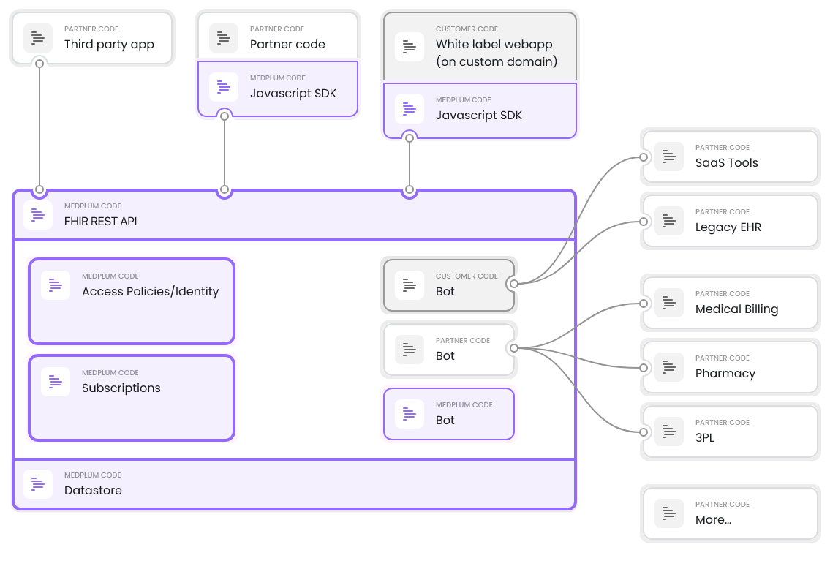
https://www.medplum.com/docs/fhir-basics

Slide 32
Immunizations
Immunization: Similar to MedicationStatement, but for vaccine records
Records
Type
Administration Date
Dosage
Route
Reactions
US Core recommends using the CVX code system for vaccine type

